Slide 1
Causes and Features of Feudalism
And the Manor System

Slide 2
Europe after Charlemagne
Charlemagne’s death marked the end of a strong, central government in Western Europe
Series of invasions destroy the Carolingian empire
Major invading groups:
  Vikings
  Magyars
  Muslims

Slide 3
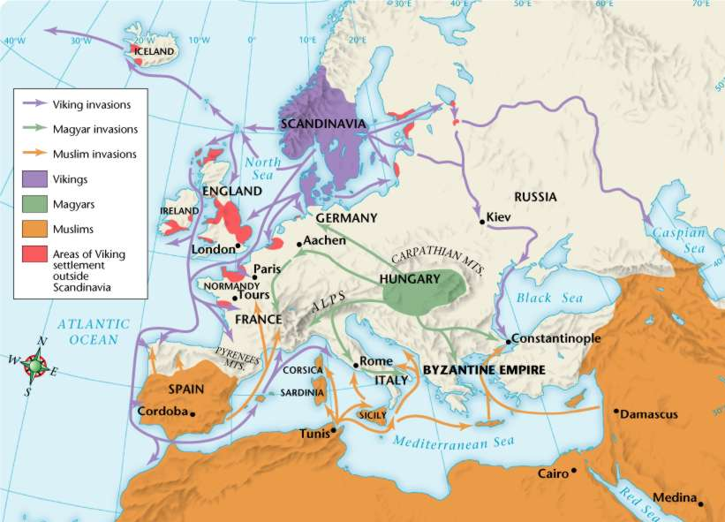

Slide 4
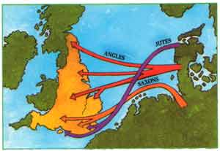
Angles and Saxons
Angles and Saxons: from continent to England
Filled power vacuum in Britain after fall of Rome
  This is where “Anglo-Saxon” comes from
Terrorized by…

Slide 5

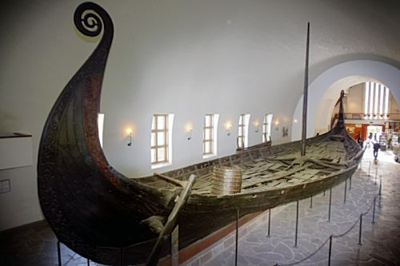
Vikings!
…they come from the land of the ice and snow…
Seafaring people from Scandinavia
  Farmers
  Warriors-longboats
  Explorers-reached Newfoundland
Plundered monasteries until converted to Christianity
Excavated longboat from the 1300s, on display in Oslo, Norway

Slide 6
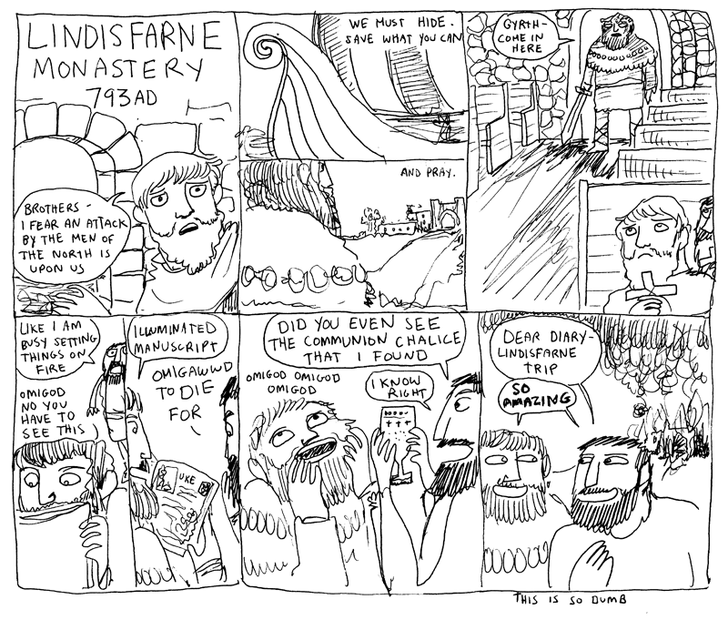

Slide 7
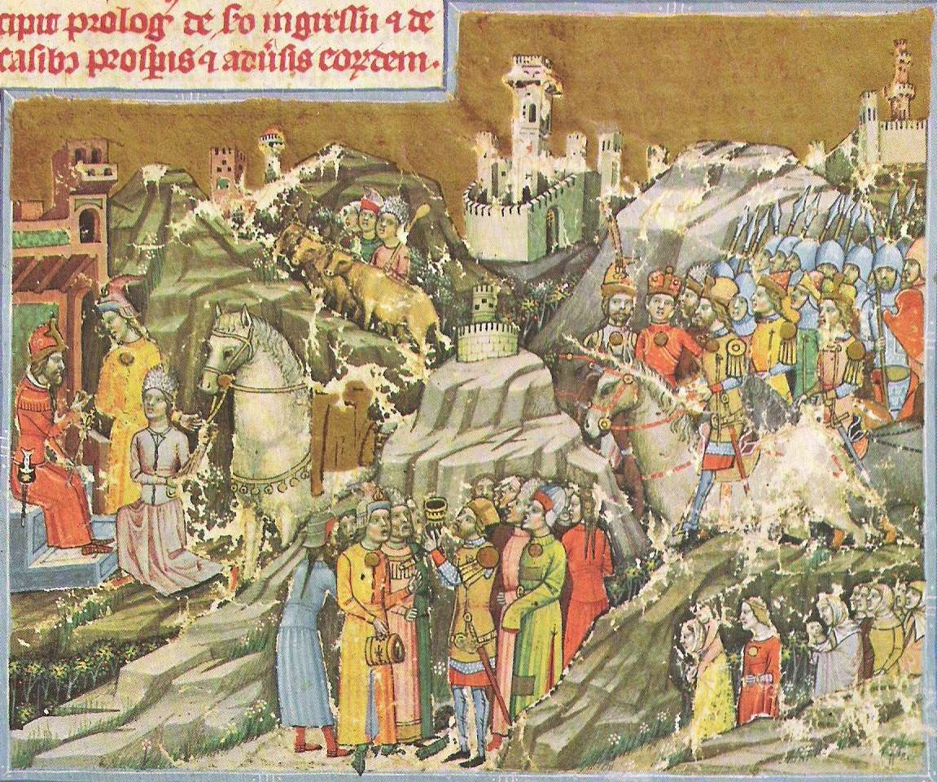
Magyars
Early Hungarian people, once hired as mercenaries by the Byzantines
  Converted to Christianity
By the 900s, the Magyars had reached Gaul and southern Italy
  Fight and pillage like Vikings
  defeated by Saxons, forced into central Europe
Attacks cease in 955

Slide 8
Muslims
Controlled territory in Spain, north Africa, Mediterranean islands, Middle East
Sought to establish a stronghold in Europe
  Plunder coastal settlements along the Mediterranean
  Becomes one cause of the Crusades

Slide 9
Feudalism
people no longer trust that a king can protect them from invaders
  Look to local rulers with their own forces
  Anyone with land and the ability to raise an army had power
nobles exchange land for loyalty and military aid

Slide 10
Feudalism
lord
loyalty, military aid, other services
fiefs
homage
vassal
Notes:
Lord – higher-ranking person in relationship
Vassal – lower-ranking person in relationship
Homage – ceremony tying lord and vassal together
Fief – grant of land w/ peasants

Slide 11
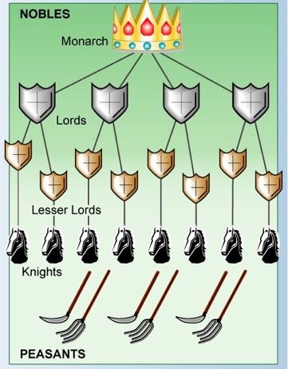
Feudalism
can be vassal and lord at the same time
can have fiefs from multiple lords
first loyalty to lord

Slide 12
The Noble Life
lord – total authority, collect rent, settle disputes
lady – active but limited
  worked in lord’s absence
  could not inherit land, but got land as part of dowry
  regained land rights if husband died first

Slide 13
The Noble Life
knights – mounted warriors
  began training at 7
  1100s – warfare decreases, tournaments start. Tournaments mimic battle and carry the same glory for the victor
chivalry – be brave, loyal, honest, fair, kind to women

Slide 14
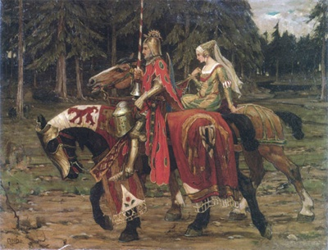
Chivalry
Knights had “three masters” under chivalry
  Feudal lord
  Heavenly lord
  Lady
Ideal knight is loyal,
brave, and courageous
Despite being a “master”
women had few rights in
society and were thought
to be inferior

Slide 15
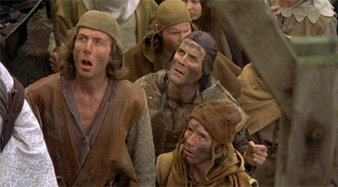
Manor Life
manor – self-sufficient estate w/ village, land, peasants
serfs – peasants who were bound to the land
lord/peasant relationships similar to feudal ones with lords
and vassals

Slide 16
Manor Life
lord
farming, work, payments
farmland, protection
manor
peasant

Slide 17
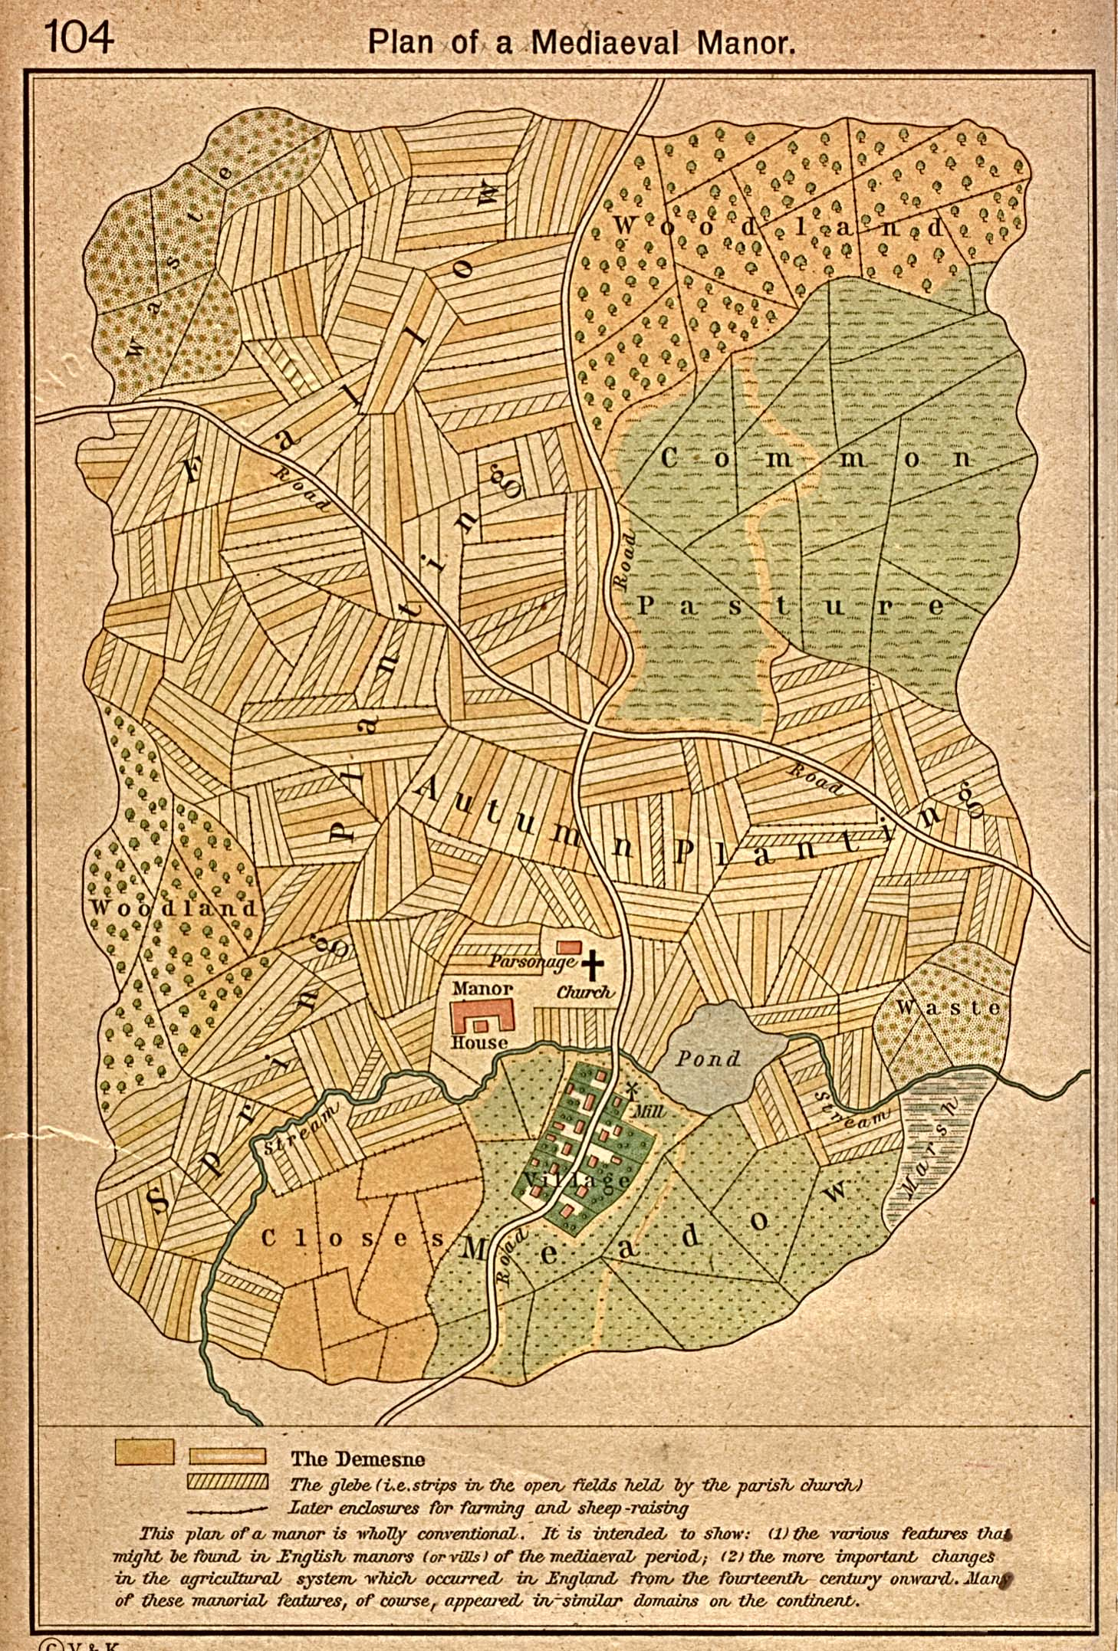
Notes:
This diagram shows a later manor, after the agricultural revolution where people learn to leave fields fallow and rotate crops

